Slide 1

Data Mining Classification: Alternative Techniques
Bayesian Classifiers
Introduction to Data Mining, 2nd Edition
by
Tan, Steinbach, Karpatne, Kumar
$$p_{1}$$

Slide 2
Bayes Classifier
A probabilistic framework for solving classification problems
Conditional Probability:
Bayes theorem:

Slide 3
Using Bayes Theorem for Classification
Consider each attribute and class label as random variables
Given a record with attributes (X₁, X₂,…, X_{d})
Goal is to predict class Y
Specifically, we want to find the value of Y that maximizes P(Y| X₁, X₂,…, X_{d} )
Can we estimate P(Y| X₁, X₂,…, X_{d} ) directly from data?

Slide 4
Using Bayes Theorem for Classification
Approach:
compute posterior probability P(Y | X₁, X₂, …, X_{d}) using the Bayes theorem
Maximum a-posteriori: Choose Y that maximizes P(Y | X₁, X₂, …, X_{d})
Equivalent to choosing value of Y that maximizes P(X₁, X₂, …, X_{d}|Y) P(Y)
How to estimate P(X₁, X₂, …, X_{d} | Y )?

Slide 5
Example Data
Given a Test Record:
Can we estimate
P(Evade = Yes | X) and P(Evade = No | X)?
In the following we will replace
Evade = Yes by Yes, and
Evade = No by No

Slide 6
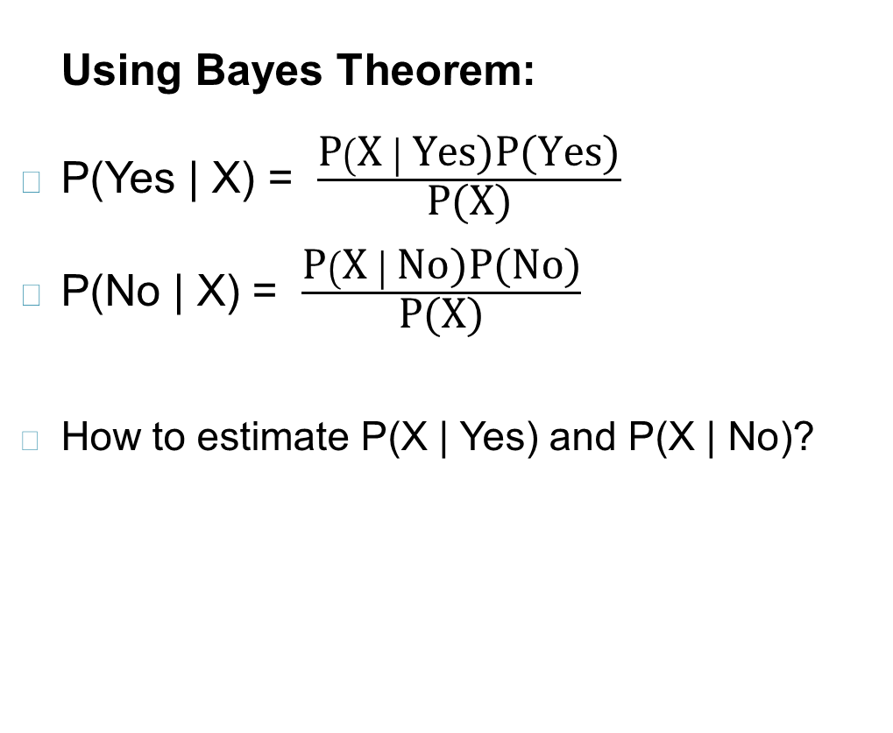
Example Data
Given a Test Record:

Slide 7
Conditional Independence
X and Y are conditionally independent given Z if P(X|YZ) = P(X|Z)
Example: Arm length and reading skills
Young child has shorter arm length and limited reading skills, compared to adults
If age is fixed, no apparent relationship between arm length and reading skills
Arm length and reading skills are conditionally independent given age

Slide 8
Naïve Bayes Classifier
Assume independence among attributes X_{i} when class is given:
P(X₁, X₂, …, X_{d} |Y_{j}) = P(X₁| Y_{j}) P(X₂| Y_{j})… P(X_{d}| Y_{j})
Now we can estimate P(X_{i}| Y_{j}) for all X_{i} and Y_{j} combinations from the training data
New point is classified to Y_{j} if P(Y_{j}) Π P(X_{i}| Y_{j}) is maximal.

Slide 9
Naïve Bayes on Example Data
Given a Test Record:
P(X | Yes) =
P(Refund = No | Yes) x
P(Divorced | Yes) x
P(Income = 120K | Yes)
P(X | No) =
P(Refund = No | No) x
P(Divorced | No) x
P(Income = 120K | No)

Slide 10
Estimate Probabilities from Data
P(y) = fraction of instances of class y
e.g., P(No) = 7/10, P(Yes) = 3/10
For categorical attributes: P(X_{i} =c| y) = n_{c}/ n
where |X_{i} =c| is number of instances having attribute value X_{i} =c and belonging to class y
Examples:
P(Status=Married|No) = 4/7 P(Refund=Yes|Yes)=0

Slide 11
Estimate Probabilities from Data
For continuous attributes:
Discretization: Partition the range into bins:
Replace continuous value with bin value
Attribute changed from continuous to ordinal
Probability density estimation:
Assume attribute follows a normal distribution
Use data to estimate parameters of distribution (e.g., mean and standard deviation)
Once probability distribution is known, use it to estimate the conditional probability P(X_{i}|Y)

Slide 12
Estimate Probabilities from Data
Normal distribution:
One for each (X_{i},Y_{i}) pair
For (Income, Class=No):
If Class=No
sample mean = 110
sample variance = 2975

Slide 13
Example of Naïve Bayes Classifier
Given a Test Record:
Naïve Bayes Classifier:
P(Refund = Yes | No) = 3/7
P(Refund = No | No) = 4/7
P(Refund = Yes | Yes) = 0
P(Refund = No | Yes) = 1
P(Marital Status = Single | No) = 2/7
P(Marital Status = Divorced | No) = 1/7
P(Marital Status = Married | No) = 4/7
P(Marital Status = Single | Yes) = 2/3
P(Marital Status = Divorced | Yes) = 1/3
P(Marital Status = Married | Yes) = 0
For Taxable Income:
If class = No: sample mean = 110
sample variance = 2975
If class = Yes: sample mean = 90
sample variance = 25
P(X | No) = P(Refund=No | No) × P(Divorced | No) × P(Income=120K | No) = 4/7 × 1/7 × 0.0072 = 0.0006
P(X | Yes) = P(Refund=No | Yes) × P(Divorced | Yes) × P(Income=120K | Yes) = 1 × 1/3 × 1.2 × 10⁻⁹ = 4 × 10⁻¹⁰
Since P(X|No)P(No) > P(X|Yes)P(Yes)
Therefore P(No|X) > P(Yes|X) => Class = No

Slide 14
Naïve Bayes Classifier can make decisions with partial information about attributes in the test record
Even in absence of information about any attributes, we can use Apriori Probabilities of Class Variable:
P(Yes) = 3/10
P(No) = 7/10
If we only know that marital status is Divorced, then:
P(Yes | Divorced) = 1/3 x 3/10 / P(Divorced)
P(No | Divorced) = 1/7 x 7/10 / P(Divorced)
If we also know that Refund = No, then
P(Yes | Refund = No, Divorced) = 1 x 1/3 x 3/10 / P(Divorced, Refund = No)
P(No | Refund = No, Divorced) = 4/7 x 1/7 x 7/10 / P(Divorced, Refund = No)
If we also know that Taxable Income = 120, then
P(Yes | Refund = No, Divorced, Income = 120) = 1.2 x10⁻⁹ x 1 x 1/3 x 3/10 / P(Divorced, Refund = No, Income = 120 )
P(No | Refund = No, Divorced Income = 120) = 0.0072 x 4/7 x 1/7 x 7/10 / P(Divorced, Refund = No, Income = 120)
Naïve Bayes Classifier:
P(Refund = Yes | No) = 3/7
P(Refund = No | No) = 4/7
P(Refund = Yes | Yes) = 0
P(Refund = No | Yes) = 1
P(Marital Status = Single | No) = 2/7
P(Marital Status = Divorced | No) = 1/7
P(Marital Status = Married | No) = 4/7
P(Marital Status = Single | Yes) = 2/3
P(Marital Status = Divorced | Yes) = 1/3
P(Marital Status = Married | Yes) = 0
For Taxable Income:
If class = No: sample mean = 110
sample variance = 2975
If class = Yes: sample mean = 90
sample variance = 25

Slide 15
Issues with Naïve Bayes Classifier
Given a Test Record:
X = (Married)
Naïve Bayes Classifier:
P(Refund = Yes | No) = 3/7
P(Refund = No | No) = 4/7
P(Refund = Yes | Yes) = 0
P(Refund = No | Yes) = 1
P(Marital Status = Single | No) = 2/7
P(Marital Status = Divorced | No) = 1/7
P(Marital Status = Married | No) = 4/7
P(Marital Status = Single | Yes) = 2/3
P(Marital Status = Divorced | Yes) = 1/3
P(Marital Status = Married | Yes) = 0
For Taxable Income:
If class = No: sample mean = 110
sample variance = 2975
If class = Yes: sample mean = 90
sample variance = 25
P(Yes) = 3/10
P(No) = 7/10
P(Yes | Married) = 0 x 3/10 / P(Married)
P(No | Married) = 4/7 x 7/10 / P(Married)

Slide 16
Issues with Naïve Bayes Classifier
Consider the table with Tid = 7 deleted
Naïve Bayes Classifier:
P(Refund = Yes | No) = 2/6
P(Refund = No | No) = 4/6
P(Refund = Yes | Yes) = 0
P(Refund = No | Yes) = 1
P(Marital Status = Single | No) = 2/6
P(Marital Status = Divorced | No) = 0
P(Marital Status = Married | No) = 4/6
P(Marital Status = Single | Yes) = 2/3
P(Marital Status = Divorced | Yes) = 1/3
P(Marital Status = Married | Yes) = 0/3
For Taxable Income:
If class = No: sample mean = 91
sample variance = 685
If class = No: sample mean = 90
sample variance = 25
Given X = (Refund = Yes, Divorced, 120K)
P(X | No) = 2/6 X 0 X 0.0083 = 0
P(X | Yes) = 0 X 1/3 X 1.2 X 10⁻⁹ = 0
Naïve Bayes will not be able to classify X as Yes or No!

Slide 17



Issues with Naïve Bayes Classifier
If one of the conditional probabilities is zero, then the entire expression becomes zero
Need to use other estimates of conditional probabilities than simple fractions
Probability estimation:
n: number of training instances belonging to class y
n_{c}: number of instances with X_{i} = c and Y = y
v: total number of attribute values that X_{i} can take
p: initial estimate of (P(X_{i} = c|y) known apriori
m: hyper-parameter for our confidence in p
$$original: P\left(X_{i}=c\right|y)=\frac{n_{c}}{n}$$
$$Laplace Estimate: P\left(X_{i}=c\right|y)=\frac{n_{c}+1}{n+v}$$
$$m−estimate: P\left(X_{i}=c\right|y)=\frac{n_{c}+mp}{n+m}$$

Slide 18
Example of Naïve Bayes Classifier
A: attributes
M: mammals
N: non-mammals
P(A|M)P(M) > P(A|N)P(N)
=> Mammals

Slide 19
Naïve Bayes (Summary)
Robust to isolated noise points
Handle missing values by ignoring the instance during probability estimate calculations
Robust to irrelevant attributes
Redundant and correlated attributes will violate class conditional assumption
Use other techniques such as Bayesian Belief Networks (BBN)

Slide 20
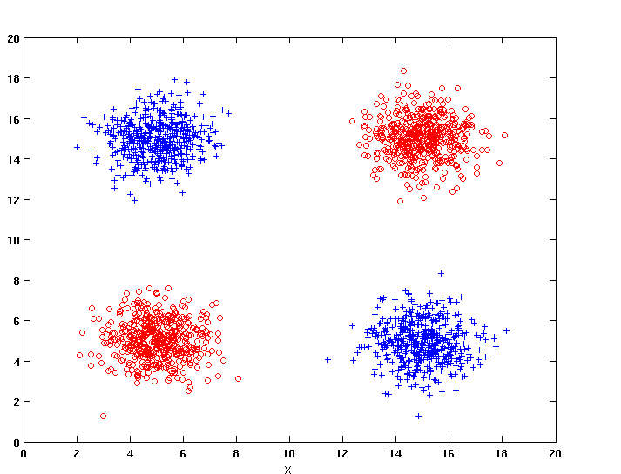
Naïve Bayes
How does Naïve Bayes perform on the following dataset?
Conditional independence of attributes is violated

Slide 21
Bayesian Belief Networks
Provides graphical representation of probabilistic relationships among a set of random variables
Consists of:
A directed acyclic graph (dag)
Node corresponds to a variable
Arc corresponds to dependence relationship between a pair of variables
A probability table associating each node to its immediate parent

Slide 22
Conditional Independence
D is parent of C
A is child of C
B is descendant of D
D is ancestor of A
A node in a Bayesian network is conditionally independent of all of its nondescendants, if its parents are known

Slide 23
Conditional Independence
Naïve Bayes assumption:

Slide 24
Probability Tables
If X does not have any parents, table contains prior probability P(X)
If X has only one parent (Y), table contains conditional probability P(X|Y)
If X has multiple parents (Y₁, Y₂,…, Y_{k}), table contains conditional probability P(X|Y₁, Y₂,…, Y_{k})

Slide 25
Example of Bayesian Belief Network

Slide 26
Example of Inferencing using BBN
Given: X = (E=No, D=Yes, CP=Yes, BP=High)
Compute P(HD|E,D,CP,BP)?
P(HD=Yes| E=No,D=Yes) = 0.55 P(CP=Yes| HD=Yes) = 0.8 P(BP=High| HD=Yes) = 0.85
P(HD=Yes|E=No,D=Yes,CP=Yes,BP=High) ∝ 0.55 × 0.8 × 0.85 = 0.374
P(HD=No| E=No,D=Yes) = 0.45 P(CP=Yes| HD=No) = 0.01 P(BP=High| HD=No) = 0.2
P(HD=No|E=No,D=Yes,CP=Yes,BP=High) ∝ 0.45 × 0.01 × 0.2 = 0.0009
Classify X as Yes

